Slide 1
Logistic Regression Model
Group 10 In-class Presentation
Andrew Du
Yunjie Xu
Steven Xie
Siyuan Wang
Yunhao Zheng
Haowen Li
Zhijian Zhu

Slide 2

Agenda
Data Preparation
Data Overview
Feature Engineering (Standardization & Feature Selection)
Logistic Regression (SKlearn)
Bias-Variance Tradeoff
Hyperparameter tuning
What is C
Grid search
Results Interpretation
Direct Optimization
Objective function
Solving the Objective Function in Python
Results Interpretation

Slide 3
Data Preparation

Slide 4
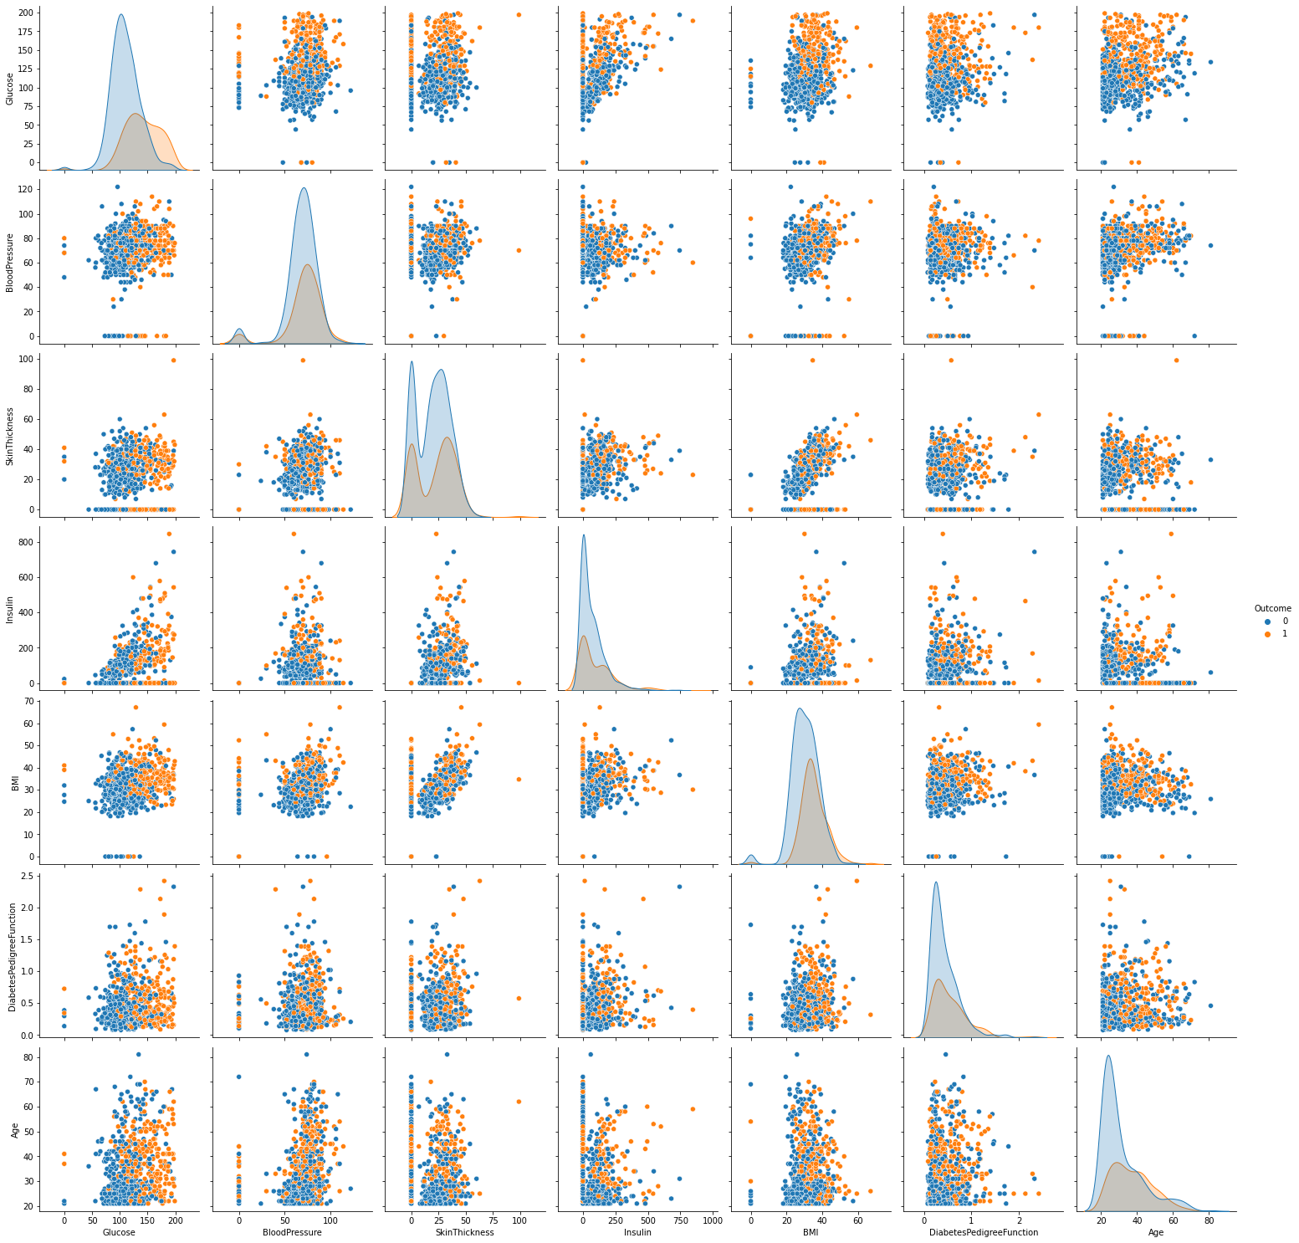
Data Overview
7 Features
Glucose
Blood Pressure
Skin Thickness
Insulin
BMI
Diabetes Pedigree Function
Age
Binary Outcome
Healthy (0)
Diabetics (1)

Slide 5
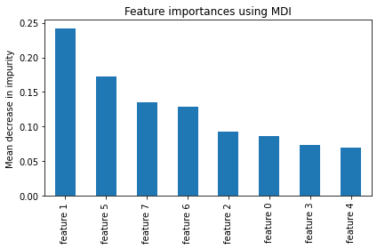
Feature Engineering
Standardization
Feature Selection
Using standard scalar to standardize the data
Extract feature importance by random forest
Feature ranking
Feature_1: Glucose
Feature_5: BMI
Feature_6: Diabetes Pedigree Function
Feature_7: Age

Slide 6
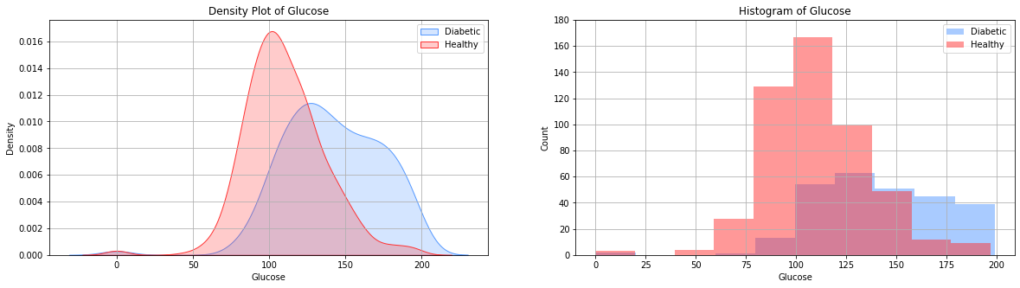
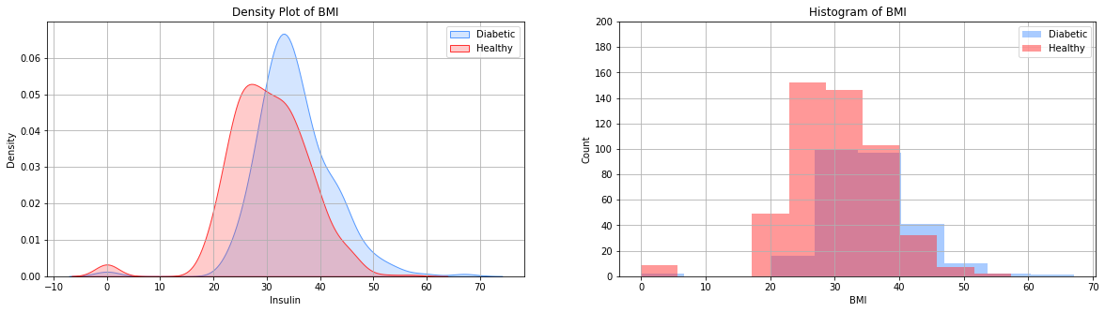
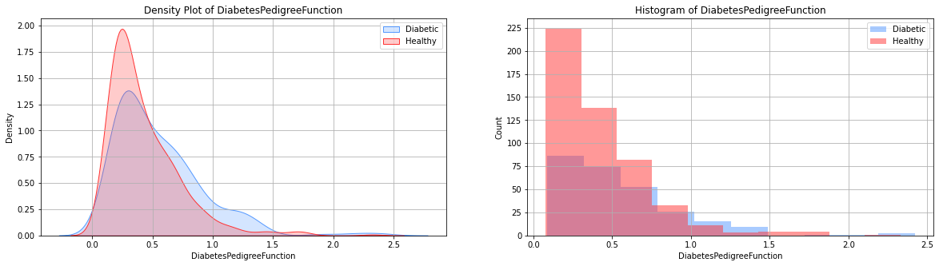
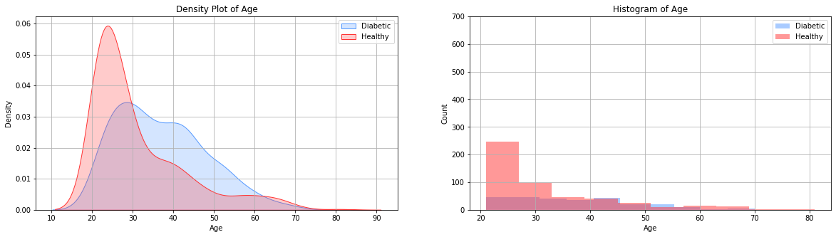
Feature 1: Glucose
Feature 5: BMI
Feature 6: Diabetes_Pedigree_Function
Feature 7: Age

Slide 7
Logistic Regression (SKlearn)

Slide 8
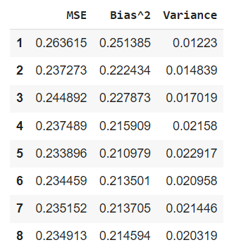
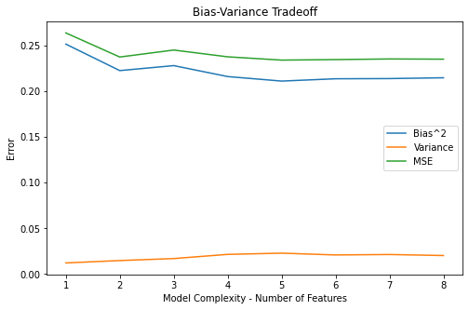
Bias-Variance Tradeoff

Slide 9
Hyperparameter Tuning - Grid Search CV
L1 - Regularized regression with scikit-learn module
Hyperparameter C - Inverse of regularization strength
Solver - ['saga', 'liblinear']

Slide 10
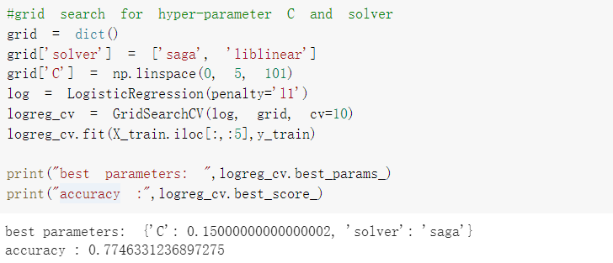
Hyperparameter Tuning - Results

Slide 11
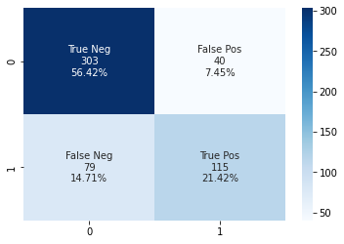
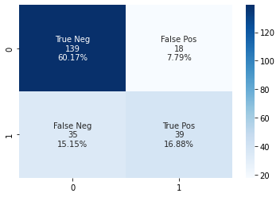
Visualize the Confusion Matrix
Training Accuracy: 0.78
Testing Accuracy: 0.77

Slide 12
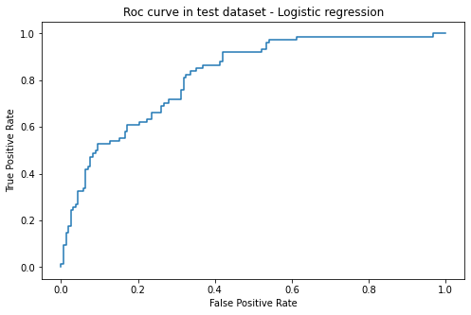
Visualize the ROC Curve

Slide 13
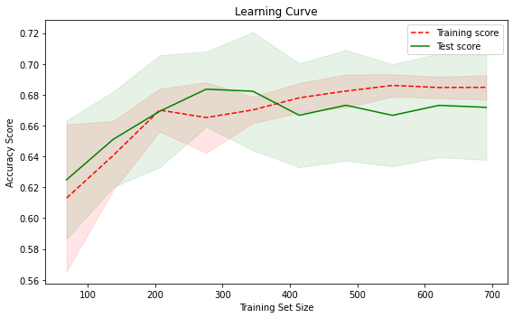
Visualize the Learning Curve

Slide 14
Direct Optimization

Slide 15
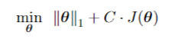
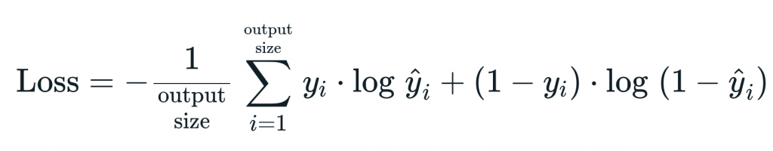
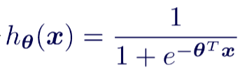
Direct Approach
by Solving an Optimization Problem
Objective Function
Where J(𝜭) is the cross-entropy loss function
ŷ are the mapped real values using the sigmoid activation function

Slide 16
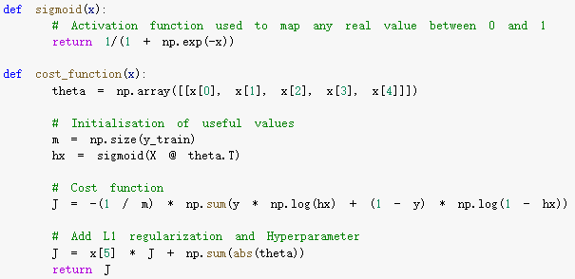
Forming the Objective Function
in Python

Slide 17
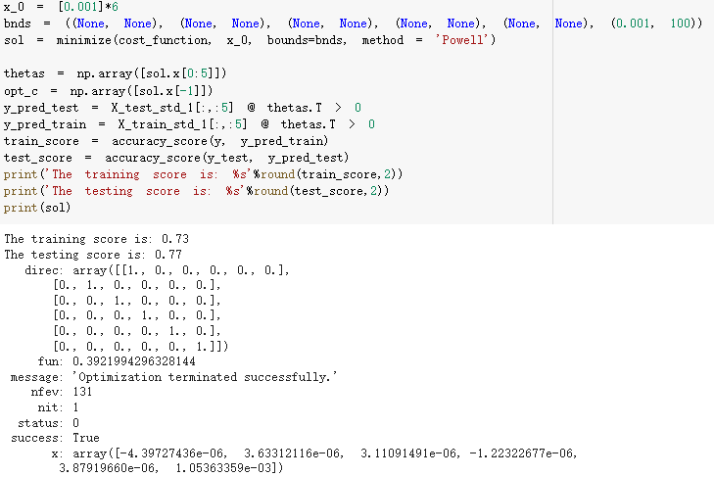
Scipy Optimization Solver
minimize()

Slide 18
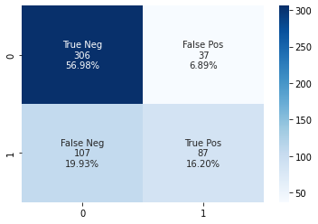
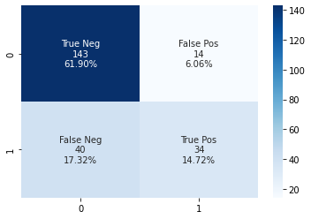
Optimization Results
Model Accuracy & Confusion Matrix
Training Accuracy: 0.73
Testing Accuracy: 0.77

Slide 19

Questions?

Slide 20

Thank you!

Slide 21
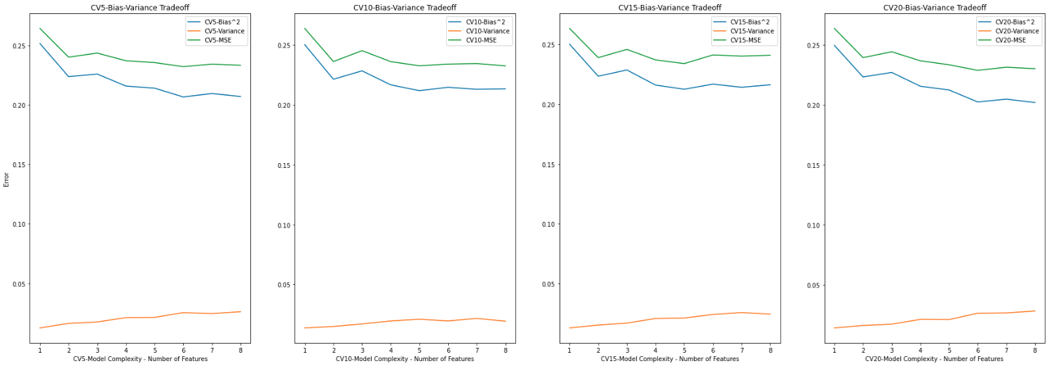
Bias-Variance Tradeoff VS.
Number of Folds in Cross Validation

